Slide 1
PRESENTATION FREE TEMPLATE D’BREED
PRESENTATION DESIGN GROUP D'BREED
DesignPattern
KKNA

Slide 2
DesignPattern
01.
원형 패턴
02.
원형 패턴 : 설명
03.
원형 패턴 : 활용
04.
원형 패턴 : 구조
05.
원형 패턴 : 샘플
06.
원형 패턴 : 관계

Slide 3
0
1
원형 패턴
PRESENTATION FREE TEMPLATE D’BREED

Slide 4
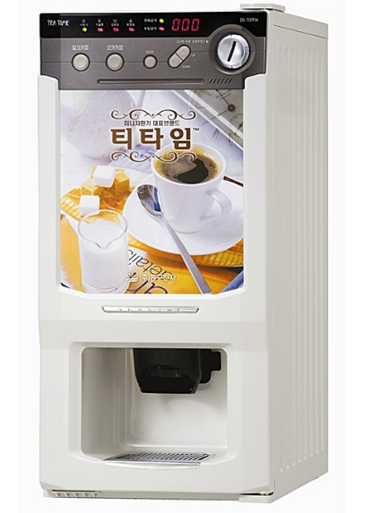
D'breed Template Contents Title
Prototype Pattern

Slide 5
0
2
원형 패턴 : 설명
PRESENTATION FREE TEMPLATE D’BREED

Slide 6
D'breed Template Contents Title
원형 패턴 : 설명
의도
원형이 되는 인스턴스를 사용하여 생성할 객체의 종류를 명시하고 이렇게 만든 견본을 복사해서 새로운 객체를 생성
동기
값의 변화로 인한 다양성과 객체 인스턴스의 최소화
예시
Dialog,Image Resource

Slide 7
0
3
원형 패턴 : 활용
PRESENTATION FREE TEMPLATE D’BREED

Slide 8
D'breed Template Contents Title
원형 패턴 : 활용
인스턴스화할 클래스를 런타임에 지정할 때 (DIALOG)
제품 클래스 계통과 병렬적으로 만드는 팩토리 클래스를 피하고 싶을 때
클래스의 인스턴스들이 서로 다른 상태 조합 중에 어느 하나일 때 원형 패턴을 쓴다. (사용자 선택에 따른 인스턴스 변화)
단점 : clone

Slide 9
0
4
원형 패턴 : 구조
PRESENTATION FREE TEMPLATE D’BREED

Slide 10
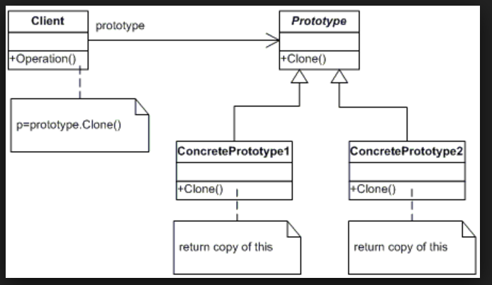
D'breed Template Contents Title
원형 패턴 : 구조

Slide 11
0
5
원형 패턴 : 샘플
PRESENTATION FREE TEMPLATE D’BREED

Slide 12
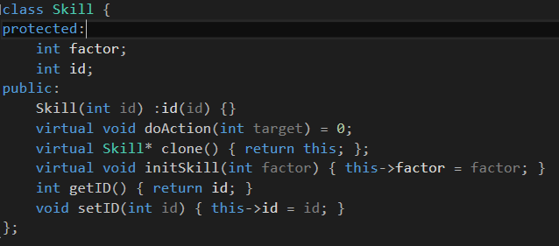
D'breed Template Contents Title
원형 패턴 : 샘플
Skill (Prototype) : 최상위 원형

Slide 13
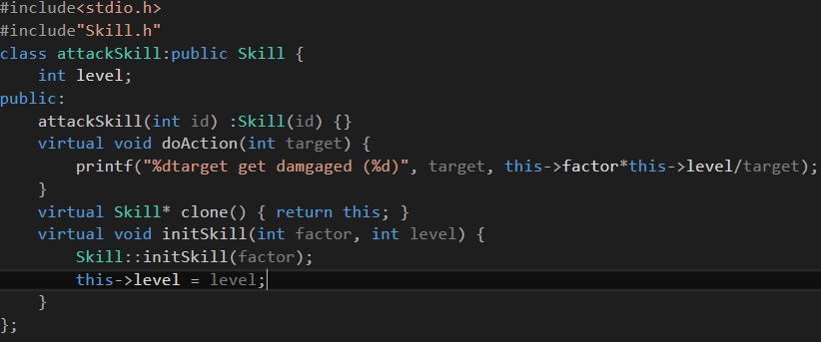
D'breed Template Contents Title
Attack skill (Concrete Prototype 1): 구체화 1

Slide 14
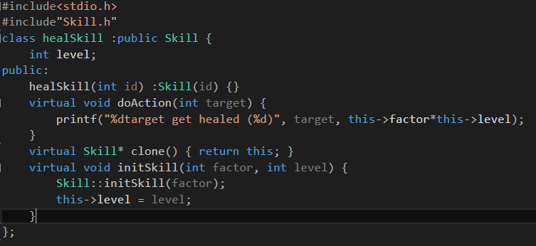
D'breed Template Contents Title
heal skill (Concrete Prototype 2): 구체화 2

Slide 15
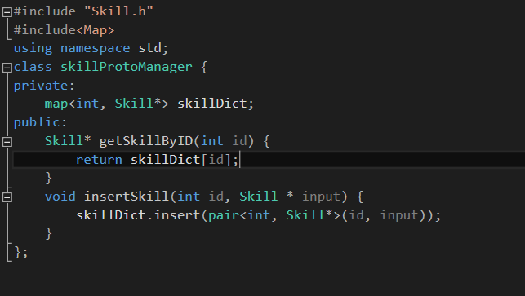
D'breed Template Contents Title
ProtoManager : Prototype을 검색하고 관리

Slide 16
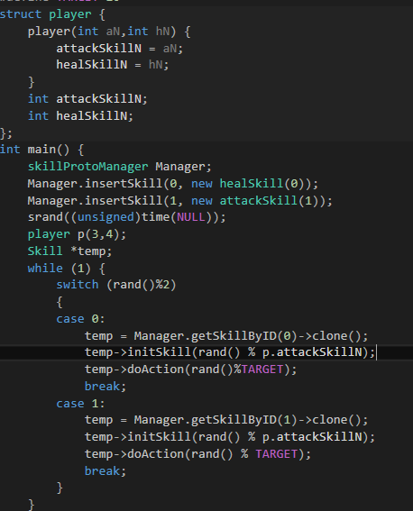
D'breed Template Contents Title
Main

Slide 17
0
6
원형 패턴 : 관계
PRESENTATION FREE TEMPLATE D’BREED

Slide 18
D'breed Template Contents Title
원형 패턴
추상 팩토리, 빌더,
팩토리 메서드

Slide 19
D'breed Template Contents Title
CONTENTS
CONTENTS 1
CONTENTS 2
CONTENTS 3
When I find myself in times of trouble Mother Mary comes to me Speaking words of wisdom Let it be And in my hour of darkness She is standing right in front of me Speaking words of wisdom Let It be Let it be, Let it be, Let it be, Let it be Whisper words of wisdom Let it be

Slide 20
D'breed Template Contents Title
CONTENTS
A company
When I find myself in times of trouble Mother Mary comes to me Speaking words of wisdom Let it
B company
And in my hour of darkness She is standing right in front of me Speaking words of wisdom Let It be
C company
When I find myself in times of trouble Mother Mary comes to me Speaking words of wisdom Let it

Slide 21
0
2
CONTENTS TITLE
PRESENTATION FREE TEMPLATE D’BREED

Slide 22
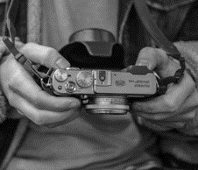


D'breed Template Contents Title
PEOPLE
When I find myself in times of trouble Mother Mary comes to me Speaking words of wisdom Let it be And in my hour of darkness She is standing right in front of me Speaking words of wisdom Let It be Let it be, Let it be, Let it be, Let it be Whisper words of wisdom Let it be
100%

Slide 23
D'breed Template Contents Title
CONTENTS
When I find myself in times of trouble Mother Mary comes to me Speaking words of wisdom Let it be And in my hour of darkness She is standing right in front of me Speaking words of wisdom Let It be Let it be, Let it be, Let it be, Let it be Whisper words of wisdom Let it be

Slide 24
0
3
CONTENTS TITLE
PRESENTATION FREE TEMPLATE D’BREED

Slide 25
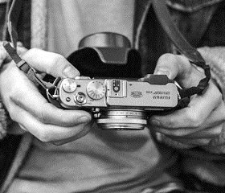


D'breed Template Contents Title
CONTENTS
CONTENTS
CONTENTS
When I find myself in times of trouble Mother Mary comes to me Speaking words of wisdom Let it be And in my hour of darkness She is standing right in front of me Speaking words of wisdom Let It be Let it be, Let it be, Let it be, Let it be Whisper words of wisdom Let it be
When I find myself in times of trouble Mother Mary comes to me Speaking words of wisdom Let it be And in my hour of darkness She is standing right in front of me Speaking words of wisdom Let It be Let it be, Let it be, Let it be, Let it be Whisper words of wisdom Let it be
When I find myself in times of trouble Mother Mary comes to me Speaking words of wisdom Let it be And in my hour of darkness She is standing right in front of me Speaking words of wisdom Let It be Let it be, Let it be, Let it be, Let it be Whisper words of wisdom Let it be

Slide 26
D'breed Template Contents Title
CONTENTS
CONTENTS
When I find myself in times of trouble Mother Mary comes to me Speaking words of wisdom Let it be And in my hour of darkness She is standing right in front of me Speaking words of wisdom Let It be Let it be, Let it be, Let it be, Let it be Whisper words of wisdom Let it be
When I find myself in times of trouble Mother Mary comes to me Speaking words of wisdom Let it be And in my hour of darkness She is standing right in front of me Speaking words of wisdom Let It be Let it be, Let it be, Let it be, Let it be Whisper words of wisdom Let it be

Slide 27
0
4
CONTENTS TITLE
PRESENTATION FREE TEMPLATE D’BREED

Slide 28
D'breed Template Contents Title
CONTENTS
When I find myself in times of trouble Mother Mary comes to me Speaking words of wisdom Let it be And in my hour of darkness She is standing right in front of me Speaking words of wisdom Let It be Let it be, Let it be, Let it be, Let it be Whisper words of wisdom Let it be
CONTENTS
CONTENTS
When I find myself in times of trouble Mother Mary comes to me Speaking words of wisdom Let it be And in my hour of darkness She is standing right in front of me Speaking words of wisdom Let It be Let it be, Let it be, Let it be, Let it be Whisper words of wisdom Let it be
When I find myself in times of trouble Mother Mary comes to me Speaking words of wisdom Let it be And in my hour of darkness She is standing right in front of me Speaking words of wisdom Let It be Let it be, Let it be, Let it be, Let it be Whisper words of wisdom Let it be

Slide 29
D'breed Template Contents Title
CONTENTS
Contents | Contents | Contents | Contents | Contents
Contents | 1,000 | 1,000 | 2,000 | 1,000
Contents | 2,000 | 1,000 | 2,000 | 2,000
Contents | 1,000 | 2,000 | 1,000 | 1,000
Contents | 2,000 | 1,000 | 1,000 | 2,000
Contents | 1,000 | 1,000 | 2,000 | 1,000
Contents | 1,000 | 1,000 | 1,000 | 2,000
Contents | 2,000 | 2,000 | 1,000 | 2,000
Contents | 2,000 | 2,000 | 2,000 | 2,000
Contents | 1,000 | 2,000 | 1,000 | 1,000
Contents | 2,000 | 2,000 | 2,000 | 2,000

Slide 30
PRESENTATION FREE TEMPLATE D’BREED
PRESENTATION DESIGN GROUP D'BREED
THANK YOU
www.dbreed.co.kr

